Slide 1
FY19
GREENHOUSE GAS EMISSIONS
UPDATE
City of Wilmington
Department of Public Services

Slide 2
Greenhouse Gas Emission
First Inventory – 2007 Baseline
City of Wilmington is a US Conference of Mayors Climate Protection Agreement signatory (2007)
  Resolution to reduce greenhouse gas emissions (GHG) 58% by 2050

Slide 3
Greenhouse Gas Emissions
City Baseline and GHG Reduction Goals
Note: GHG emission target values adjusted from GHG Reduction Target Brief (2009) to correctly represent reduction target percentages

Slide 4
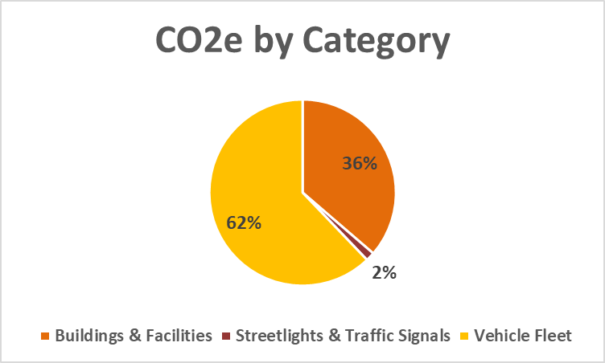
FY12 GHG Emissions
Per 2014 GHG Report
8,255 metric tons CO₂e
62% emissions from Fleet

Slide 5

Greenhouse Gas Emissions
Public Services began using ClearPath in 2019.
An emissions management software from ICLEI-USA
Utilized globally by 1500+ cities, towns & regions
Uses Local Government Operations Protocol (LGOP) for accounting and reporting GHG emissions
Standardized tool to track GHG emissions annually

Slide 6
Greenhouse Gas Emissions
ClearPath software utilizes emission factors to calculate GHG emissions.
Emission factors provided by EPA’s eGrid
eGrid = Emissions & Generation Integrated Database
Emission factors are updated every 2 yrs

Slide 7
Greenhouse Gas Emissions
eGrid Emission Factors
 | VIRGINIA/CAROLINAS REGIONAL OUTPUT EMISSION RATES
 | CO₂ | CH₄ | N₂O
eGrid 2012 | 932.87 lb/MWh | 23.9 lb/GWh | 14.6 lb/GWh
eGrid 2014 | 856.6 lb/MWh | 95.7 lb/GWh | 13.8 lb/GWh
eGrid 2016 | 805.3 lb/MWh | 67.0 lb/GWh | 11.0 lb/GWh
https://www.epa.gov/energy/emissions-generation-resource-integrated-database-egrid

Slide 8
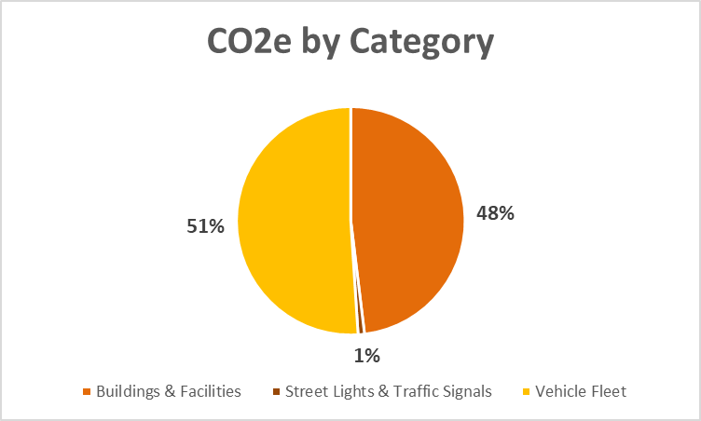
FY19 GHG Emissions
Per ClearPath software
10,651 metric tons CO₂e

Slide 9
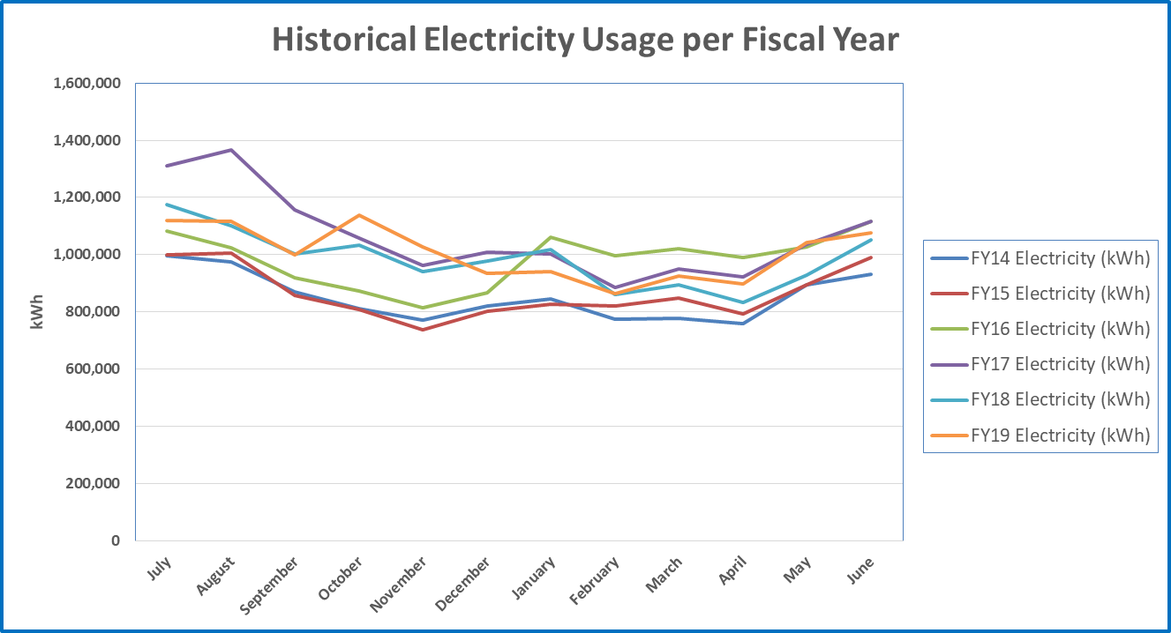
Electricity – Buildings & Facilities
FY14: 10,227,541 kWh
FY15: 10,379,269 kWh
FY16: 11,791,210 kWh
FY17: 12,771,133 kWh
FY18: 11,816,022 kWh
FY19: 12,082,244 kWh

Slide 10
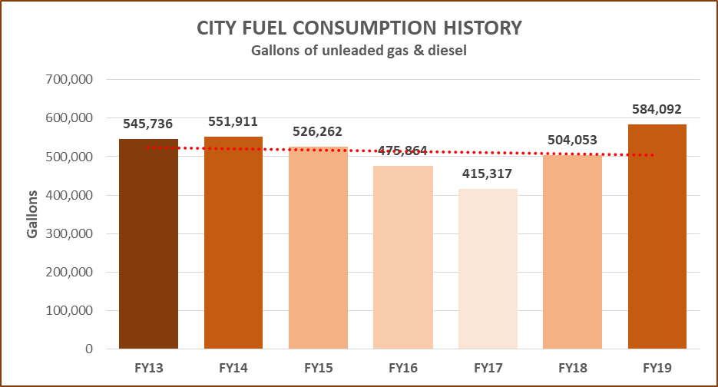
Fuel Usage Trends
FY19 Usage:
80,039 gallon increase from FY18
Increase associated with Hurricane Florence impacts

Slide 11
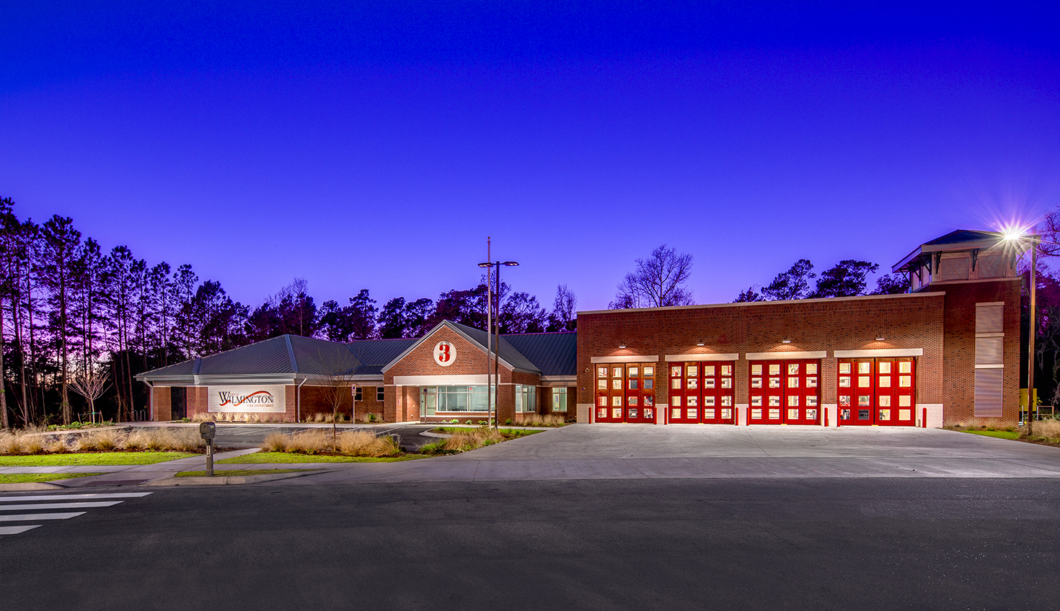
Successes – Buildings & Facilities
LEED certified buildings
  Cinema Drive Fire Station
  Lowest EUI of all the stations

Slide 12
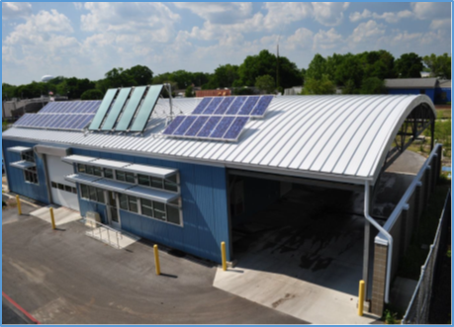
Successes – Buildings & Facilities
LEED certified buildings
Solar Energy
  Fleet & Engineering buildings
  Streetsweeper Facility – net zero!
  Currently offsets ~ 150,000 kWh/year

Slide 13
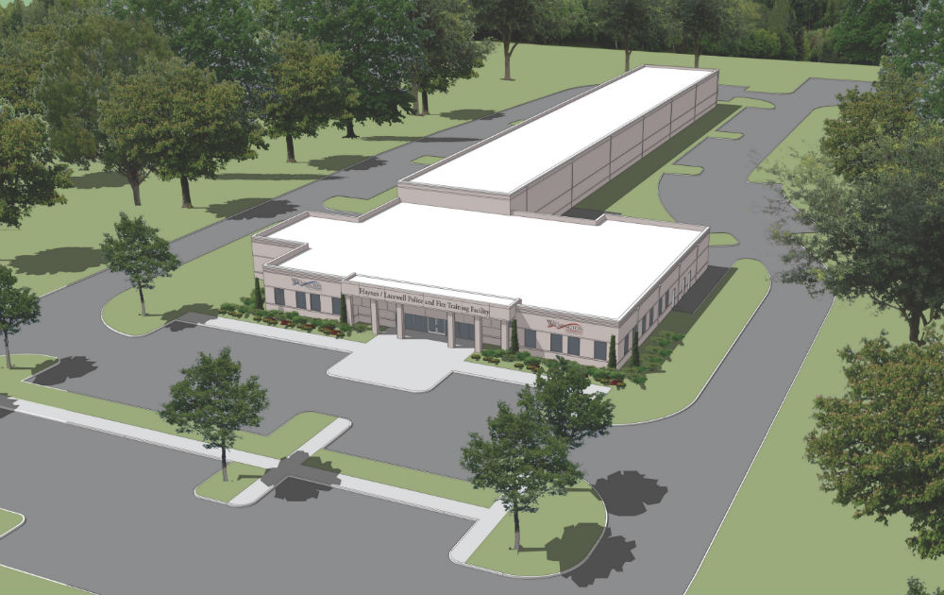
Successes – Buildings & Facilities
LEED certified buildings
Solar Energy
Duke Smart Saver Program
  Free energy modeling & design assistance
  Haynes/Lacewell Police & Fire Training Facility
  Energy efficient building envelope, HVAC system, LED lighting, motion controls

Slide 14
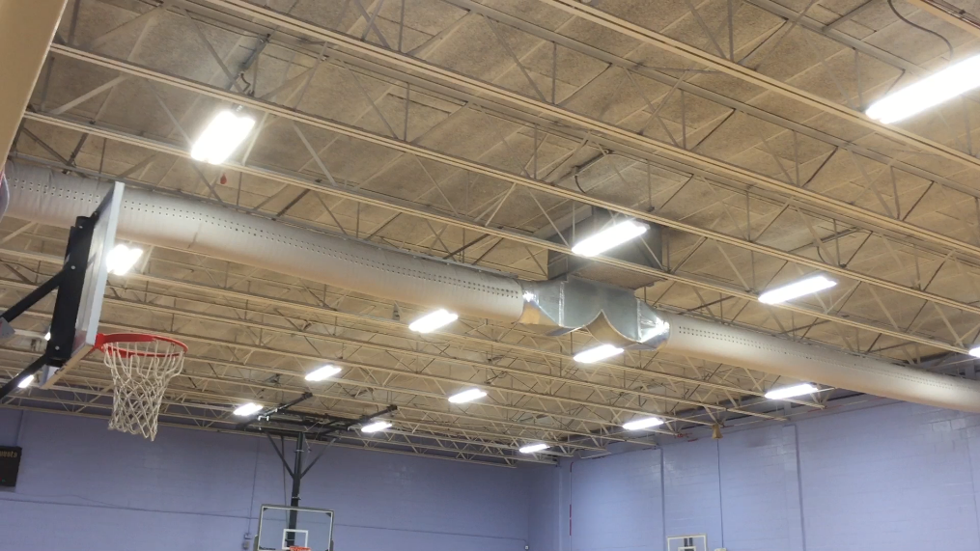
Successes – Buildings & Facilities
LEED certified buildings
Solar Energy
Duke Smart Saver
Energy Efficiency Upgrades
  LED lighting
  Chiller Systems
  HVAC units
  Motion sensors

Slide 15
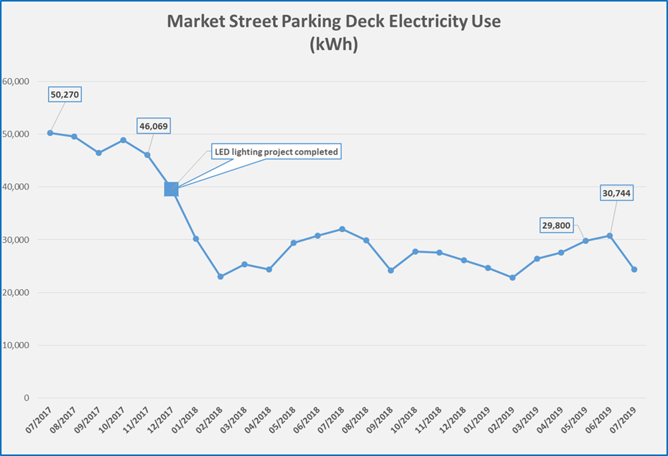
Successes – Buildings & Facilities
Market St Parking Deck
  LED lighting retrofit
  Completed Dec 2017
  40% kWh reduction
  $900/month savings

Slide 16
Opportunities – Buildings & Facilities
Green Building Policy for all new construction
More solar energy to offset electricity usage
  Solar ready new buildings
  Solar array on vacant City owned land
Continue energy efficiency retrofits of existing buildings

Slide 17
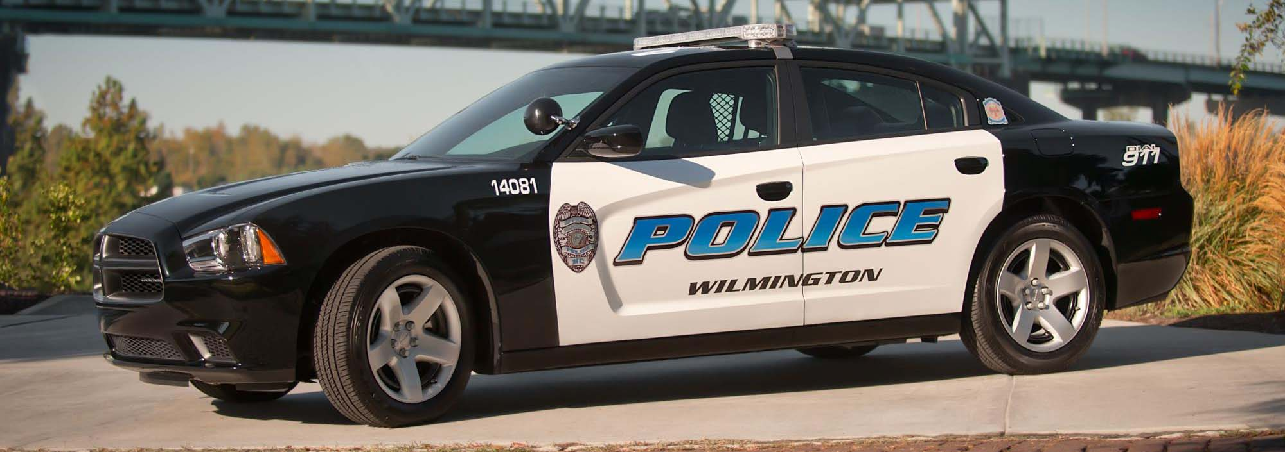
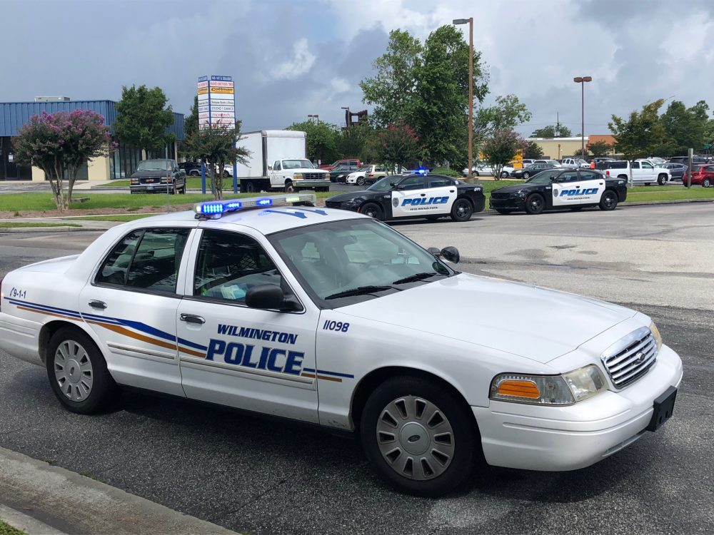
Successes – Fleet Fuel Usage
New vehicle fuel efficiency
  New Dodge Chargers average 13 mpg vs 8 mpg for aging Crown Victorias
  Chargers use a Multi-Displacement System which shuts down 4 of 8 cylinders while idling.

Slide 18
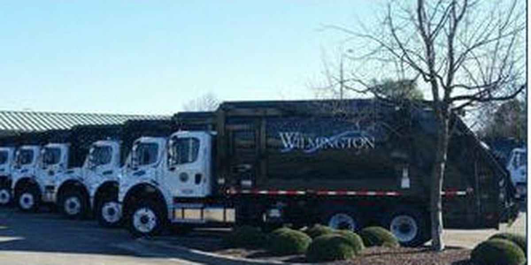
Successes – Fleet Fuel Usage
New vehicle fuel efficiency
  New Recycling & Trash services trucks average 9 mpg vs. 3 mpg for aging trucks they replaced.

Slide 19

Successes – Fleet Fuel Usage
Increased use of hybrid vehicles
  Total now up to 18 hybrids
  Toyota Prius & Camry and Ford Escape
  Cost per mile averages $0.08 vs $0.19 for other fleet passenger vehicles.
  Hybrid fleet averages 35 mpg!

Slide 20

Successes – Fleet Fuel Usage
Other Fleet fuel efficiencies:
  No idling policy
  Route optimization
  GPS technology on vehicles
  Safe driving classes as part of Safety training

Slide 21
Opportunities– Fleet Fuel Usage
Electrification of fleet vehicles
Continue hybrid purchases
Conduct a fleet audit
Electric equipment
  Boom truck
  Landscape equipment

Slide 22
Greenhouse Gas Reduction
Next Steps
Annual GHG reporting using ClearPath software
Utilize ClearPath forecasting & planning capabilities to map 2050 pathway
Utilize the Sustainability Committee to vet GHG reduction strategies and present to EMT

